Slide 1

Crime Analytics
Team 4
Rijuta Wagh Siddhi Kulkarni Akshay Gavandi

Slide 2

Project Idea and Motivation
Residential safety places nearby the university
1
Understand and analyze the criminal activities in city area
2

Slide 3

Data Source and Analytics Platform
Crime incidences in city of Chicago from 2001 to present
https://catalog.data.gov/dataset/crimes-2001-to-present-398a4
Dataset size: 1.6GB
6.65 million reported crimes
Databricks
Faster processing
Handles big data

Slide 4

Exploratory Data Analysis

Slide 5
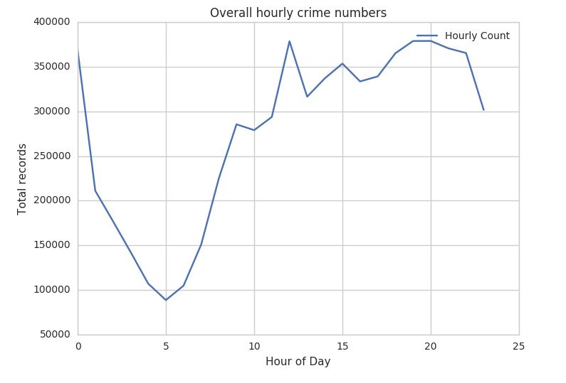
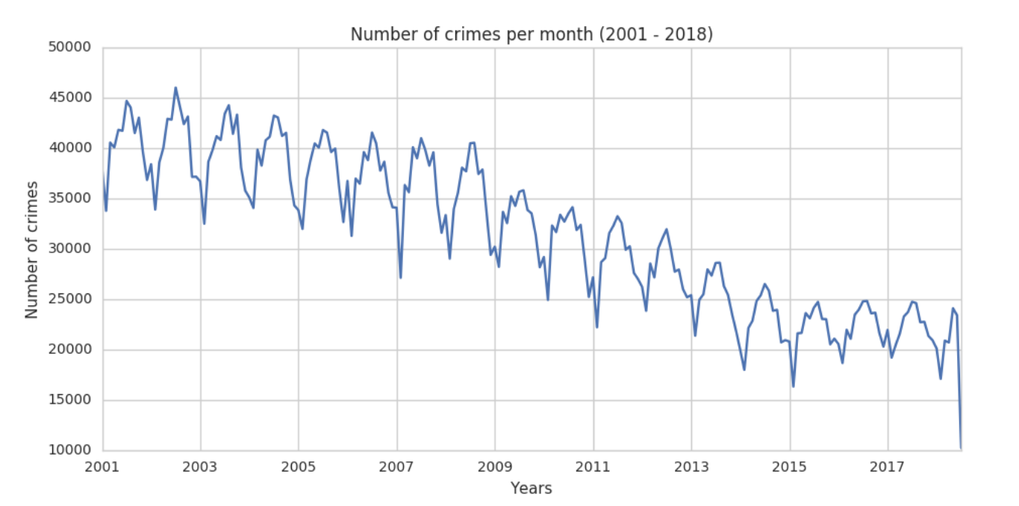
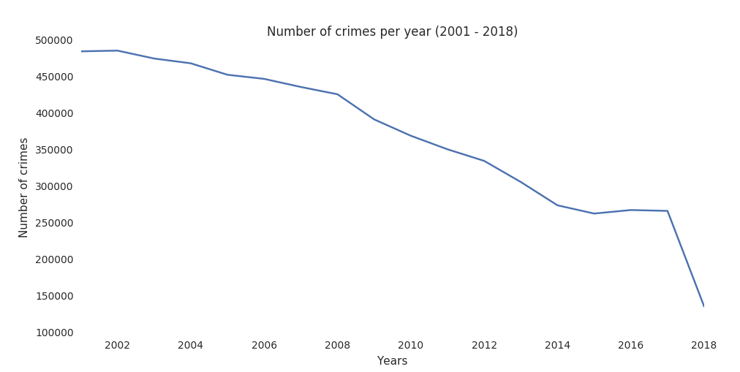
Crime Occurrence
Yearly - Decreasing crime rate
Monthly - Periodic and decreasing rate
Hourly – Maximum crime rates at 12 noon and midnight.
Minimum crime rate at 5am

Slide 6
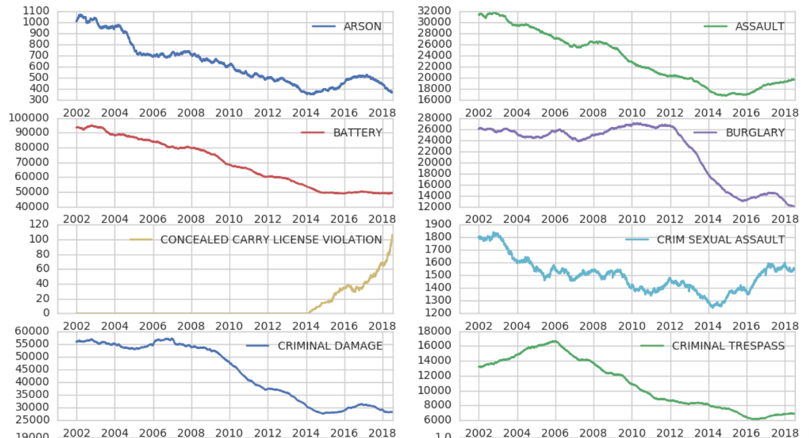
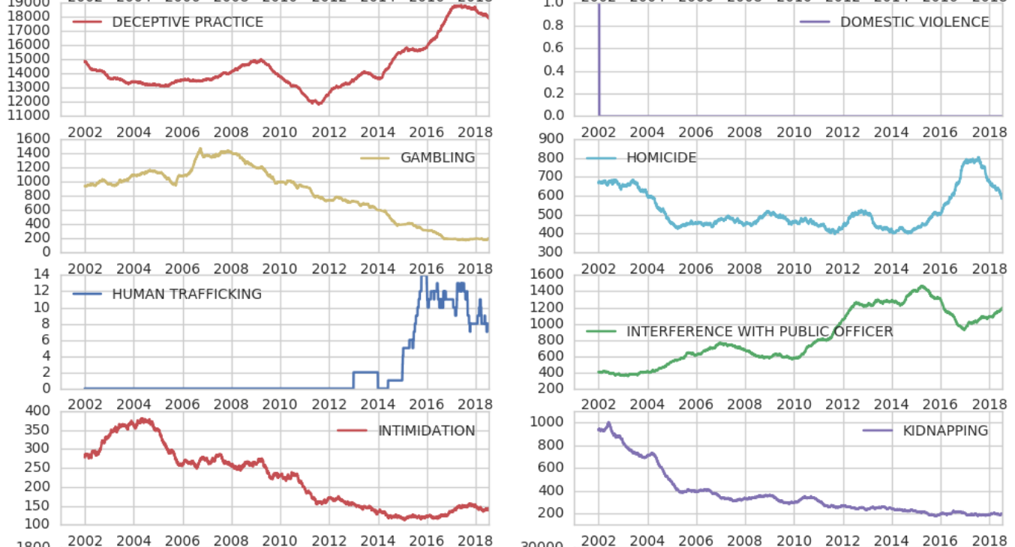
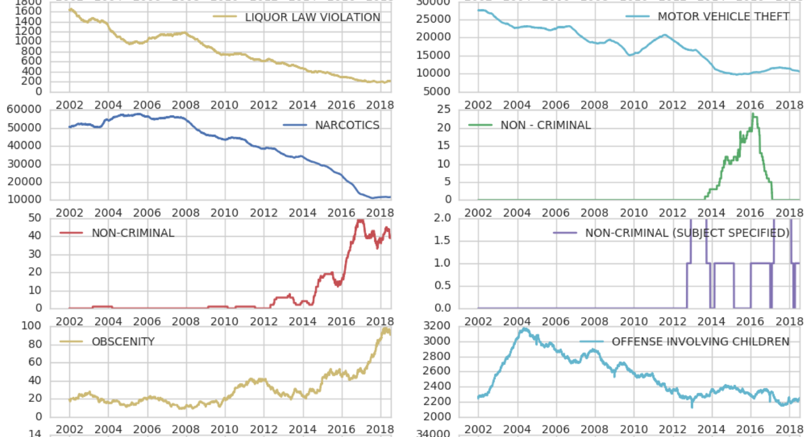
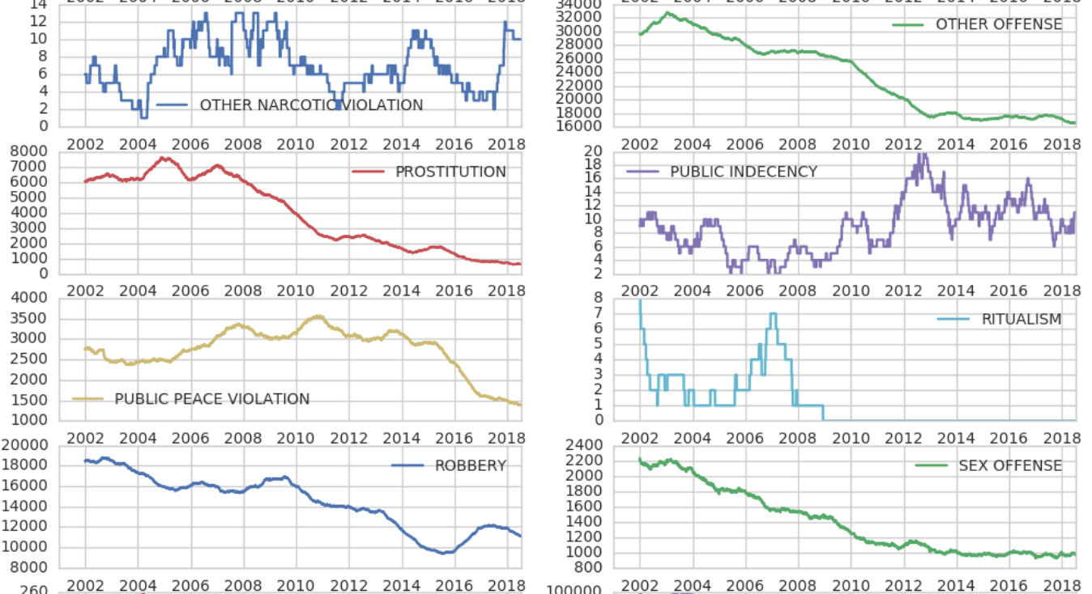
Trends for Various Crime Types

Slide 7
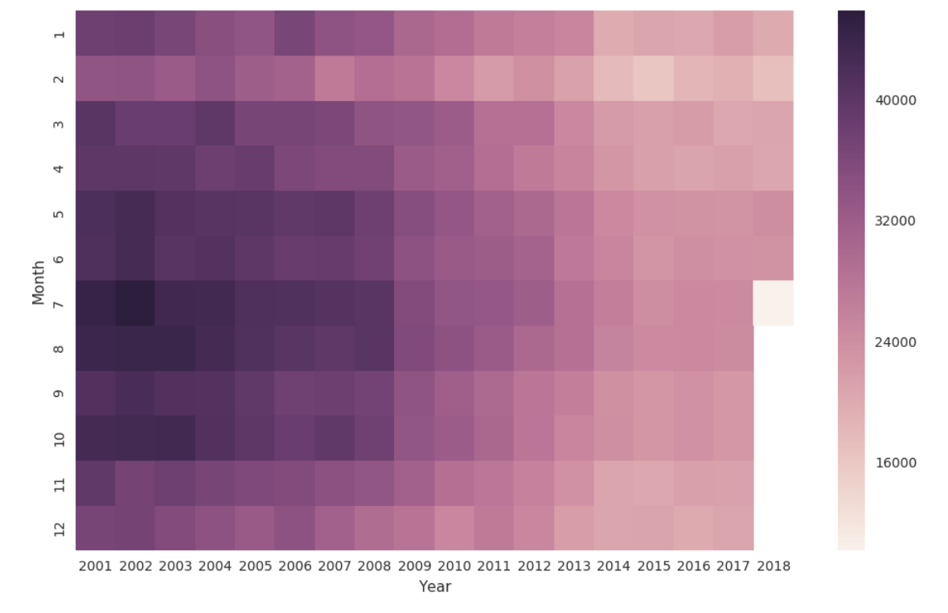
Heatmap Monthly Crime count
Gradual decrease in crime rates
Most crimes occur between May and October
February has the lowest crime
count

Slide 8
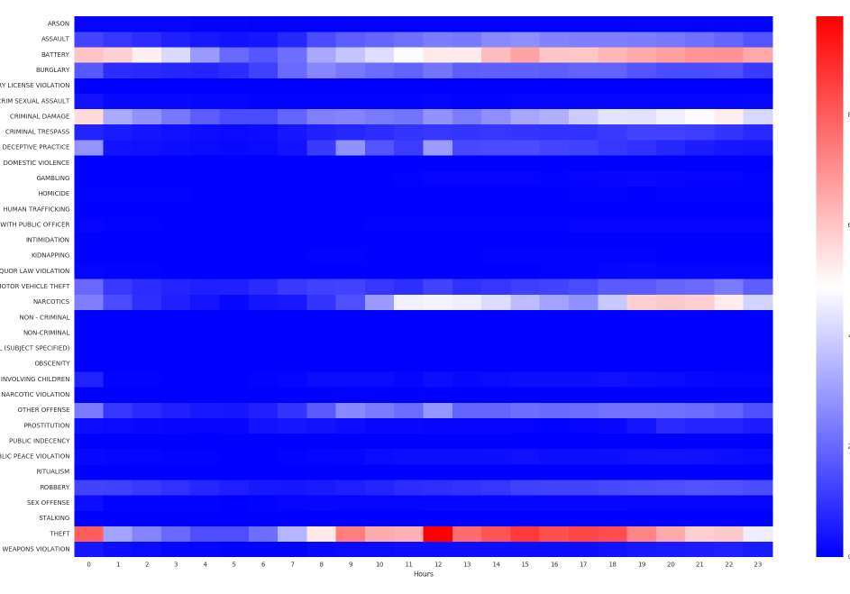
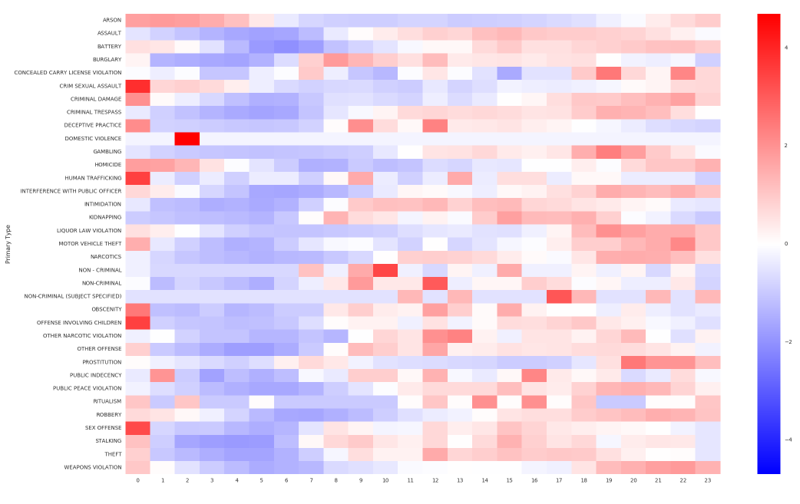
Hourly Crime Type
Before and After Renormalization

Slide 9
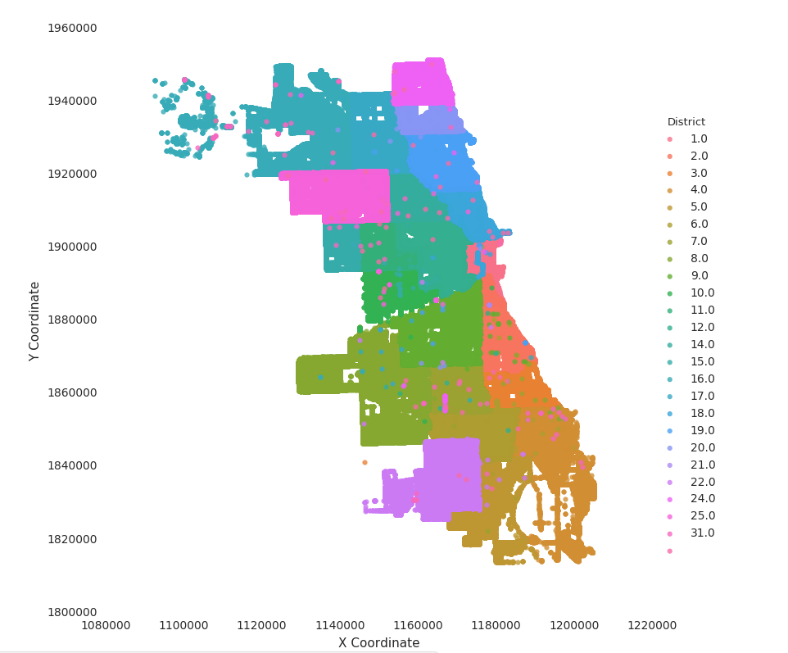
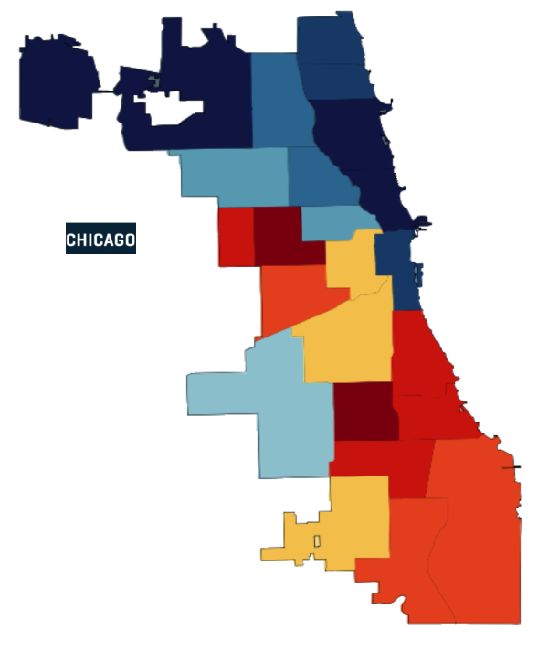
Finding Data Discrepancies

Slide 10
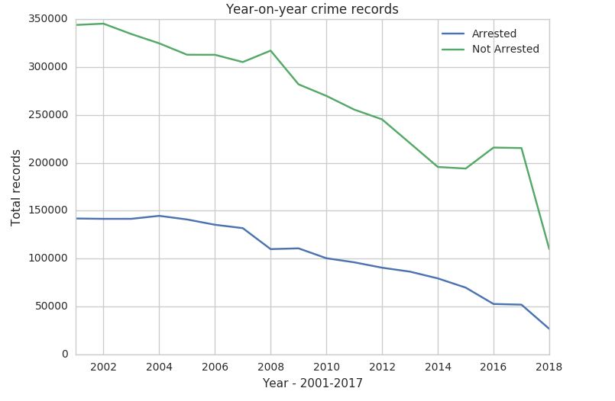
Evolution of Crime
Decrease in crime rate
Increase in percent arrest
Gap between crime rate and arrest rate is reducing meaning more criminals are arrested for the crime committed

Slide 11
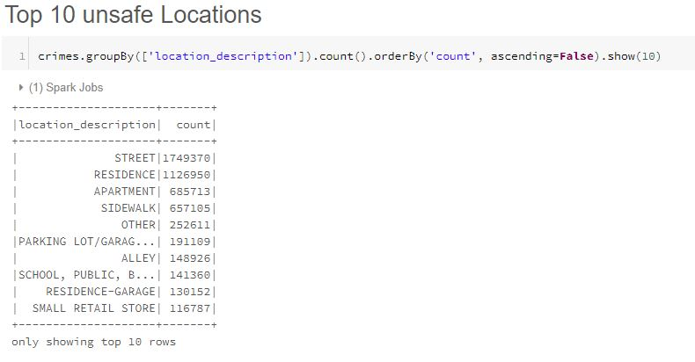
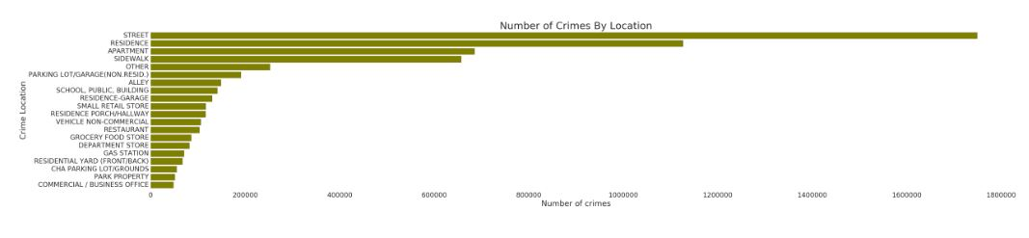
Peak Time for Criminal Activities
12AM, 12PM and 8PM
Least criminal activities at 5AM

Slide 12
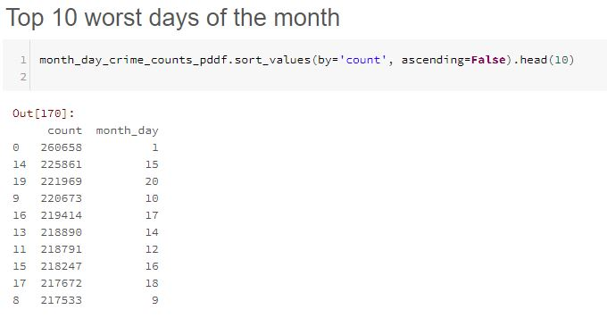
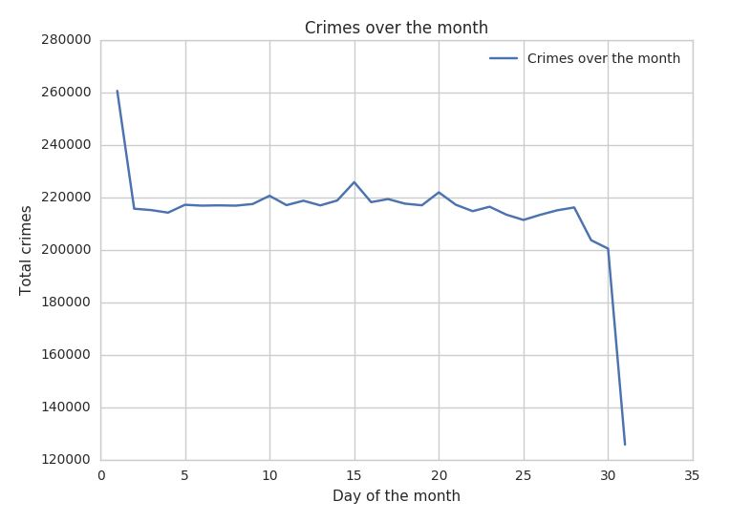
Worst Days of the Month
Highest crime rates are observed at start of the month (Pay Day)
Theft being the most contributing crime

Slide 13
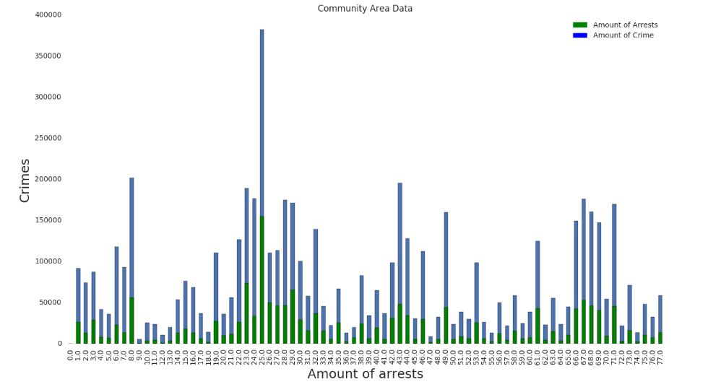
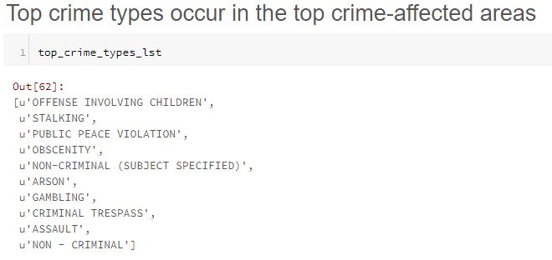

Slide 14
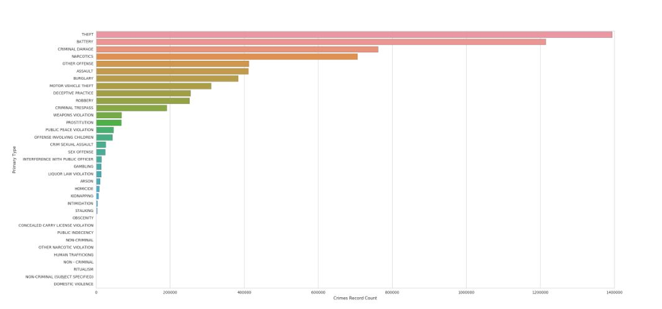
Chicago Crime Arrest Rate
Feature Selection For Logistic Regression
Location Description
Arrest
Domestic
Beat
District
Ward
Community Area
Hour
Week
Day
Year
Month
Date
Model Accuracy = 69.37%
Primary Type | recall_rate | true_positive_rate | f_measure | false_positive_rate | precision_rate
Theft | 0.933 | 0.933 | 0.778 | 0.12 | 0.6674
Narcotis | 0.837 | 0.837 | 0.68 | 0.073 | 0.573

Slide 15
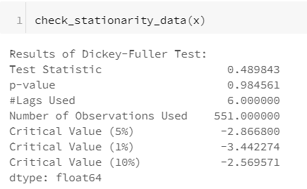
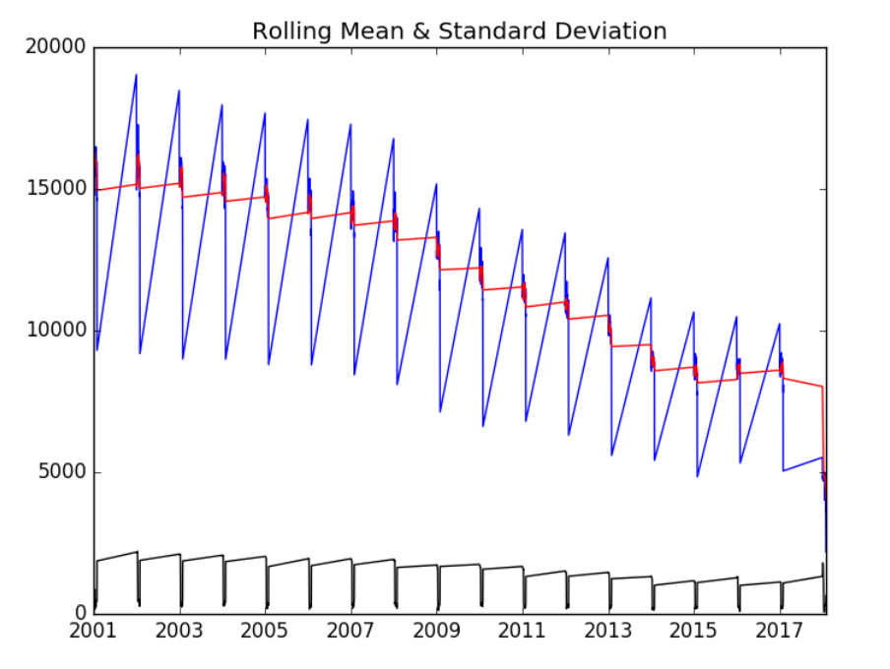
Time Series Analysis ARIMA Modelling
Average and Standard Deviation of crime count by date
Stationarity Check

Slide 16
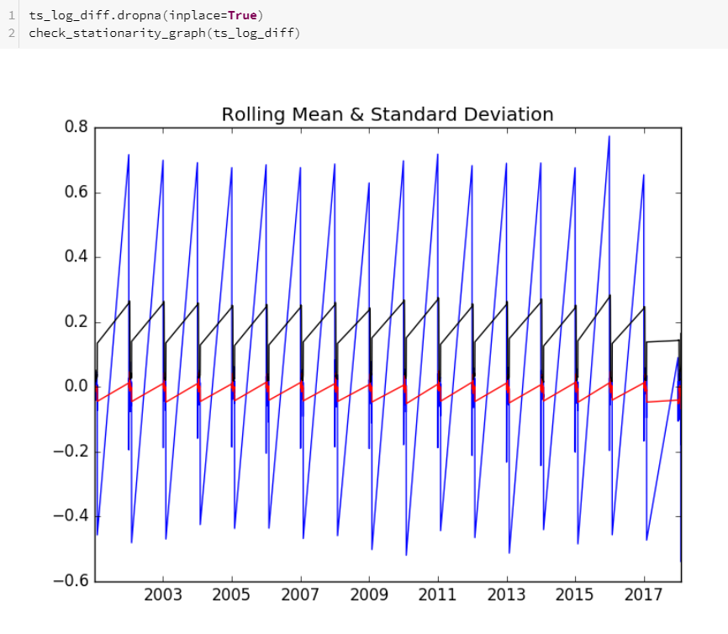
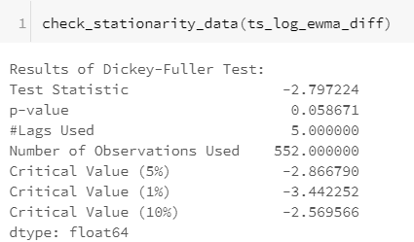
Calculated difference of moving average and log value of crime count
Calculated P values and statistics

Slide 17
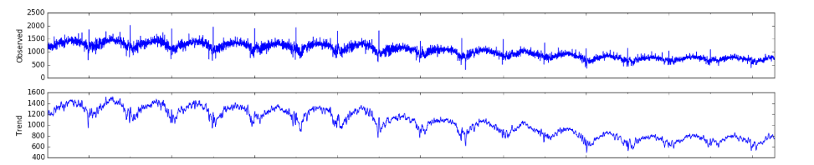
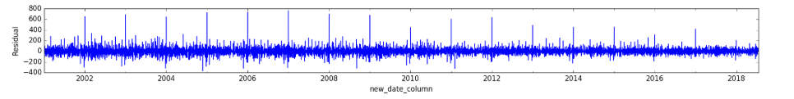
Time Series Decomposition
Trend – Shows increasing and decreasing crime values in the time series
Residual – Accounts for random variations in series

Slide 18
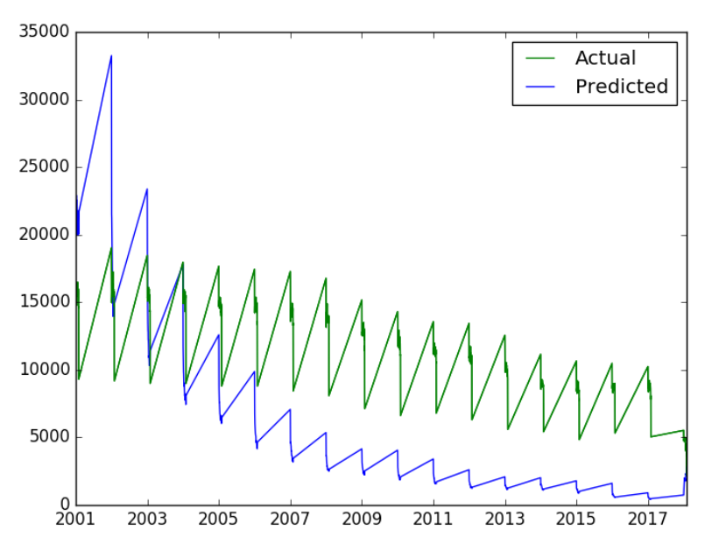
Poor ARIMA Model performance

Slide 19
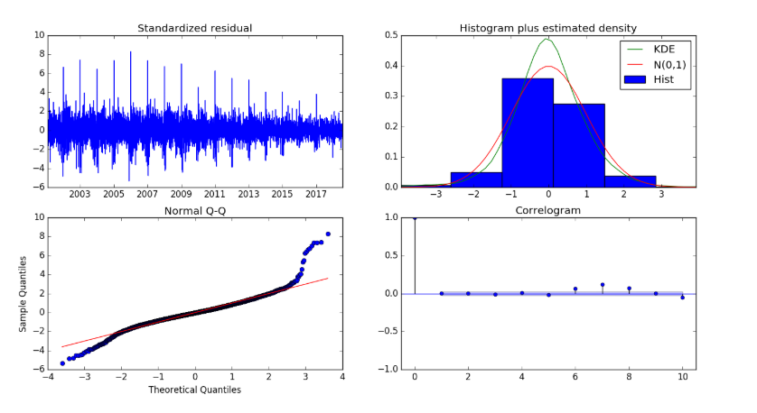
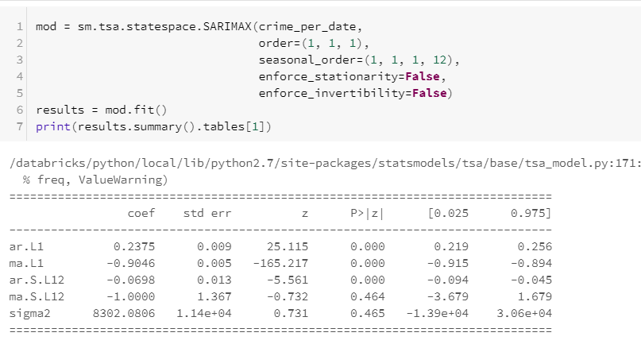
Seasonal ARIMA Model (SARIMAX)
Improving the crime prediction using SARIMAX by choosing the best parameter combination
SARIMAX(1,1,1)x(1,1,1,12) yields the lowest AIC value 75783.3

Slide 20
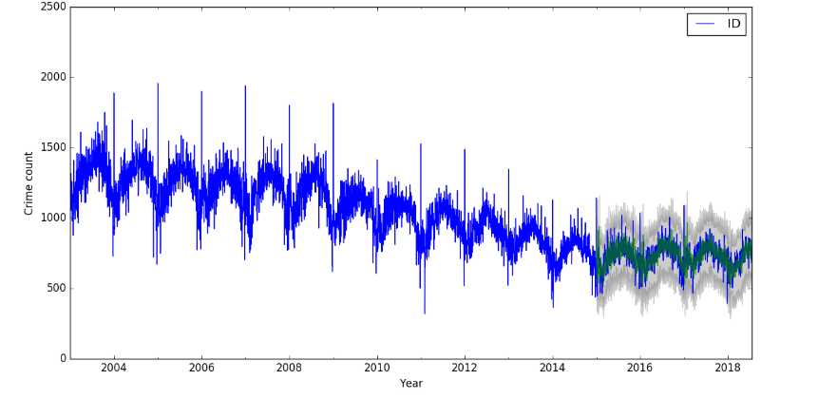
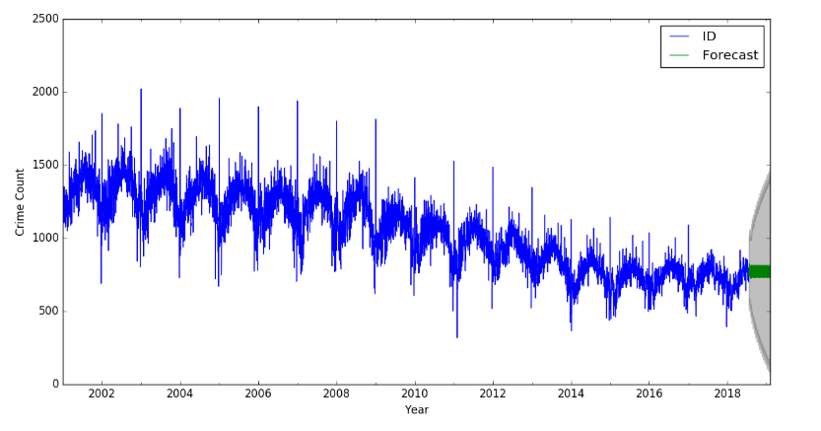
Producing and Visualizing Crime Forecasts
Compared the observed crime count to the forecasted crime count
Forecast start at 2015-01-01 to present
Captured seasonality towards the end of the year

Slide 21
References
https://data.cityofchicago.org/Public-Safety/Crimes-2001-to-present/ijzp-q8t2
https://www.kaggle.com/currie32/crimes-in-chicago
https://datascienceplus.com/spark-dataframes-exploring-chicago-crimes/
https://datascienceplus.com/spark-dataframes-exploring-chicago-crimes/
https://github.com/ajitkoduri/Chicago-Crime-Analysis/blob/master/Chicago%20Sex%20Crimes%20Analysis.ipynb
https://towardsdatascience.com/an-end-to-end-project-on-time-series-analysis-and-forecasting-with-python-4835e6bf050b

Slide 22
Conclusion
Exploratory Analysis on Criminal Activities in Chicago City
Found data discrepancies and corrected them
Most occurring crimes by hour, month, year crime type and location
Calculated Crime and Arrest Rates using Logistic Regression with 69% accuracy score
Time Series Forecasting using ARIMA and improving model accuracy Seasonal ARIMA model to predict future crime rate
Expand the analysis for any demographic region

Slide 23
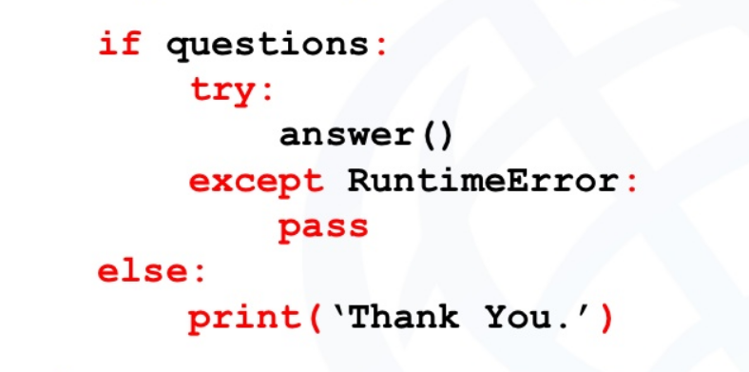
Thank You

